Slide 1
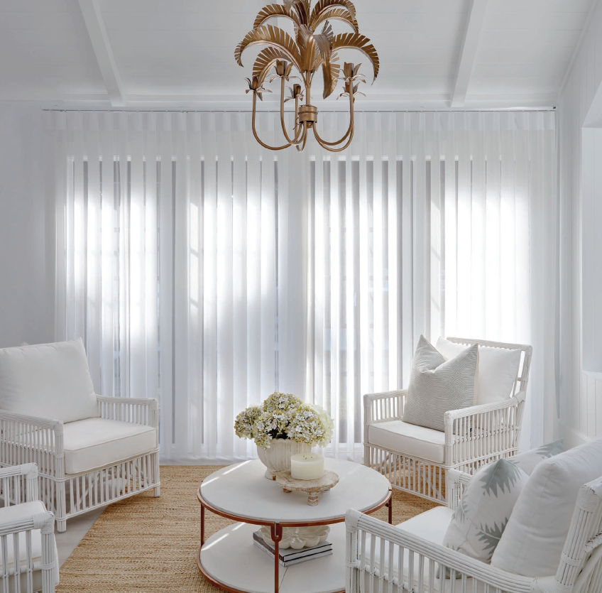
VeriShade XT Product Guide
September 2022

Slide 2
Features & Benefits

Slide 3
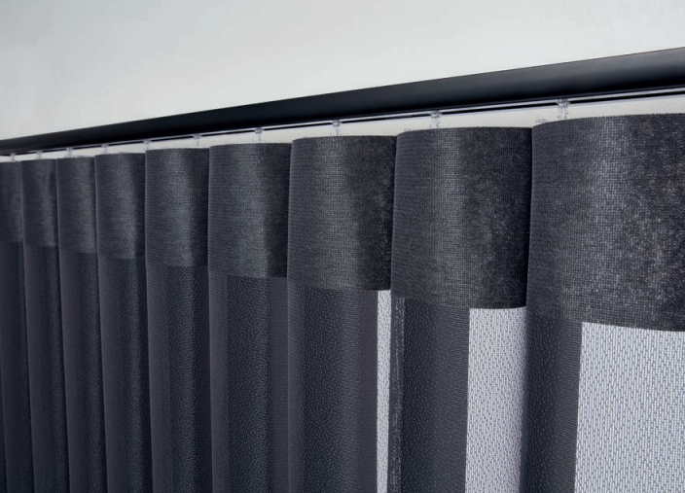
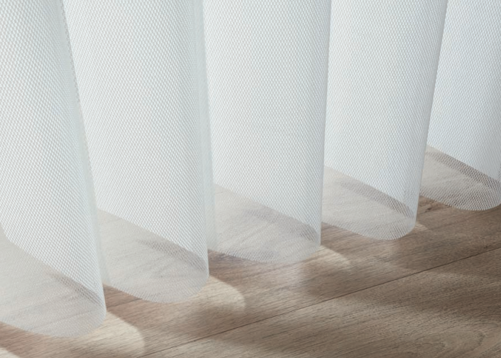
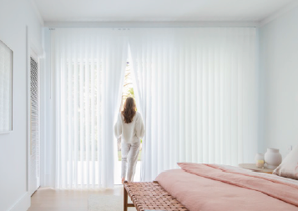
Features & Benefits
UNIQUE DESIGN
Individually curved fabric vanes feature an alternating light filtering and room darkening fabric panel. Simply turn the fabric vanes for sheer light control or total privacy.
CHILD SAFE
Designed with child safety in mind, Weathermaster VeriShade XT fabric has no connecting bottom chains or weights, providing a safer home environment for children and pets.
FUNCTIONAL LIVING
For seamless indoor-outdoor living, conveniently walk through the individual fabric vanes whether they are opened or closed.
EASY BREEZY
Free from noisy connecting chains and bottom weights, Weathermaster VeriShade XT operates quietly and softly settles back into position.

Slide 4
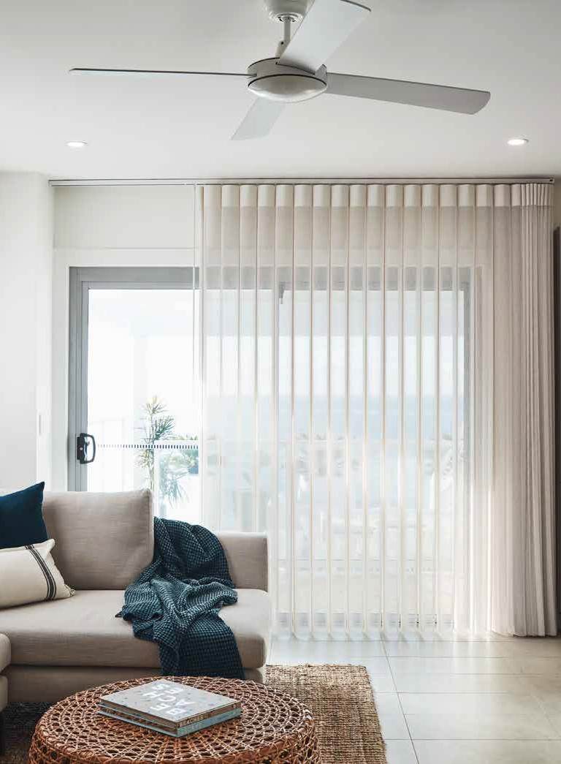
Fabric Collections &
Hardware Colours

Slide 5
Fabric Collections
ECLIPSE
The creation of the Eclipse range is inspired by the Earth and nature. This breath-taking fabric range features multi-tone yarn weave unique to the Eclipse range. Available is 6 organic hues:
Cotton
Higge
Soft Grey
Dark Grey
Iron
Night

Slide 6
Fabric Collections
PROVINCIAL LINEN
The Provincial Linen range has character and charm of the slub linen look and provincial-style aesthetic. Available in 6 contemporary hues:
Cool White
Lace
Mink
Ashen
Jet
Abyss

Slide 7
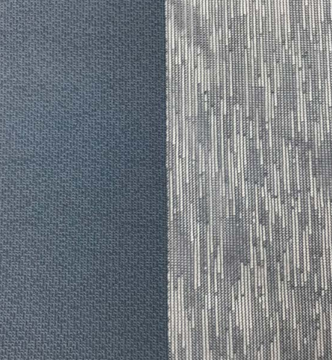
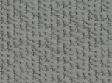
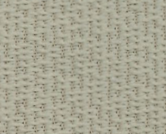
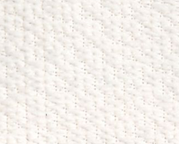
Fabric Collections
LUXURY
The Luxury fabric range draws upon organic elements to produce a unique and sophisticated fabric texture, creating a statement in an interior setting. Available in 8 diverse colourways:
Indigo
Soft Grey
Strike Grey
Herringbone
Cotton
Lucent
Flax
Sable

Slide 8
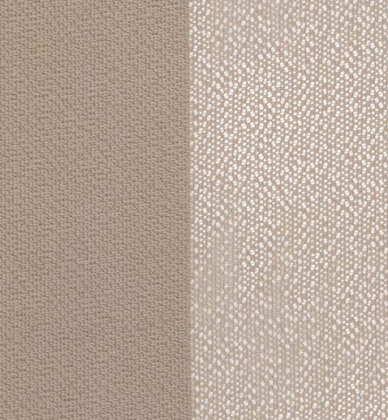
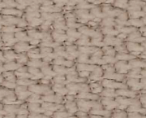
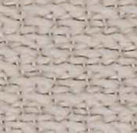
Fabric Collections
MIST
The beautiful Mist range offers a timeless style inspired by modern interior design trends.
Available in 7 popular colours:
Fawn
Shell
Pure White
Antique White
Soft Grey
Dark Grey
Black

Slide 9
Fabric Collections
STANDARD
The Standard range adds a modern contemporary aesthetic to your interior space.
Available in 6 on-trend colours:
White
Soft White
Ivory
Beige
Slate
Charcoal

Slide 10
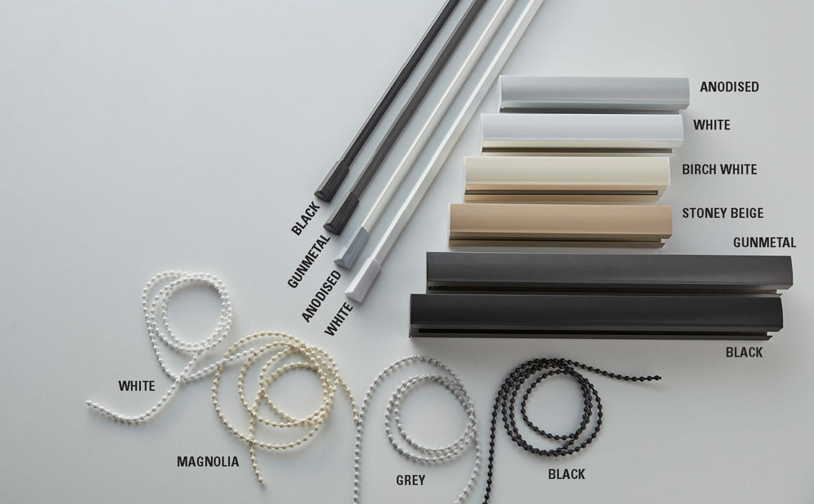
Hardware Colours

Slide 11
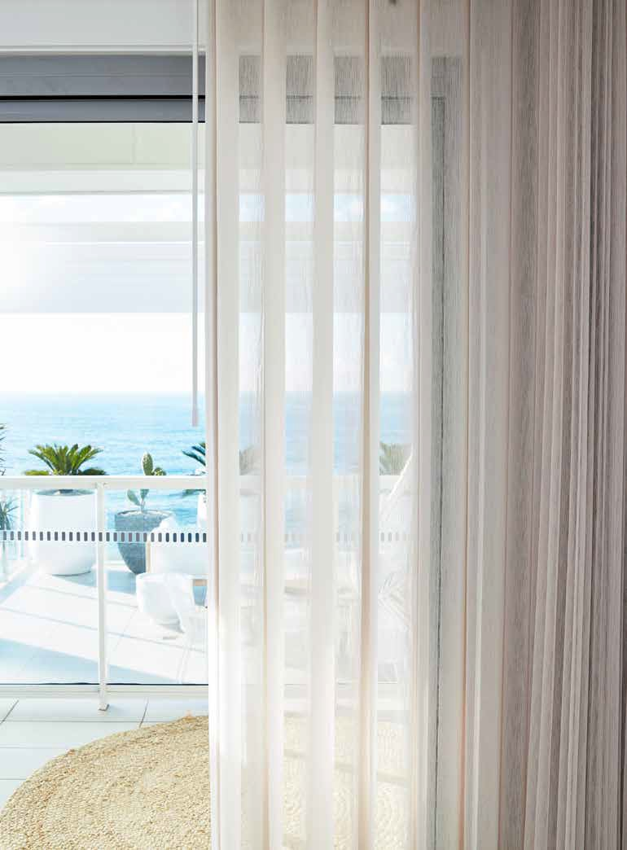
Operating Systems
Stack Options Control Sides

Slide 12
Operating Systems
TRAVELLING WAND
Designed for enhanced child safe solution and smooth operations. Using just one hand, simply rotate the fabric blades and draw the vanes across.
We recommend this control on smaller shades for optimal operation.
Maximum size: 4500 mm x 3600 mm (width x drop)
CHAIN AND CORD
Featuring a heavy-duty chain and cord, the beaded chain allows you to rotate the fabric vanes to the desired position, while the cord can be used to stack the shade.
We recommend this control on larger shades.
Maximum size : 5950 mm x 3600 mm (width x drop)

Slide 13
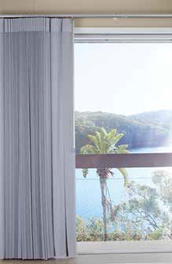
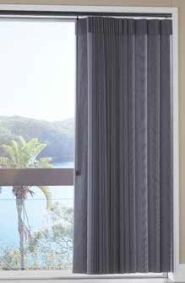
Stack Options & Control Sides
TRAVELLING WAND
Available in single stack only. The wand is on the opposite side of the stacking side.
Single Stack
Left Stack - Right Hand Control
Right Stack - Left Hand Control

Slide 14
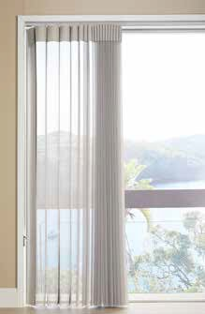
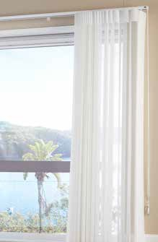
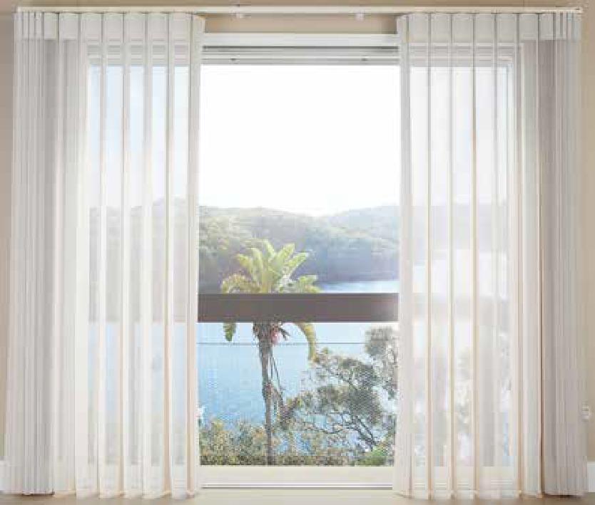
Stack Options & Control Sides
CHAIN AND CORD
Available in Single stack and Split stack options
Single Stack
Split Stack
Left Stack - Left Hand Control
Right Stack - Right Hand Control
Choose left or right control

Slide 15
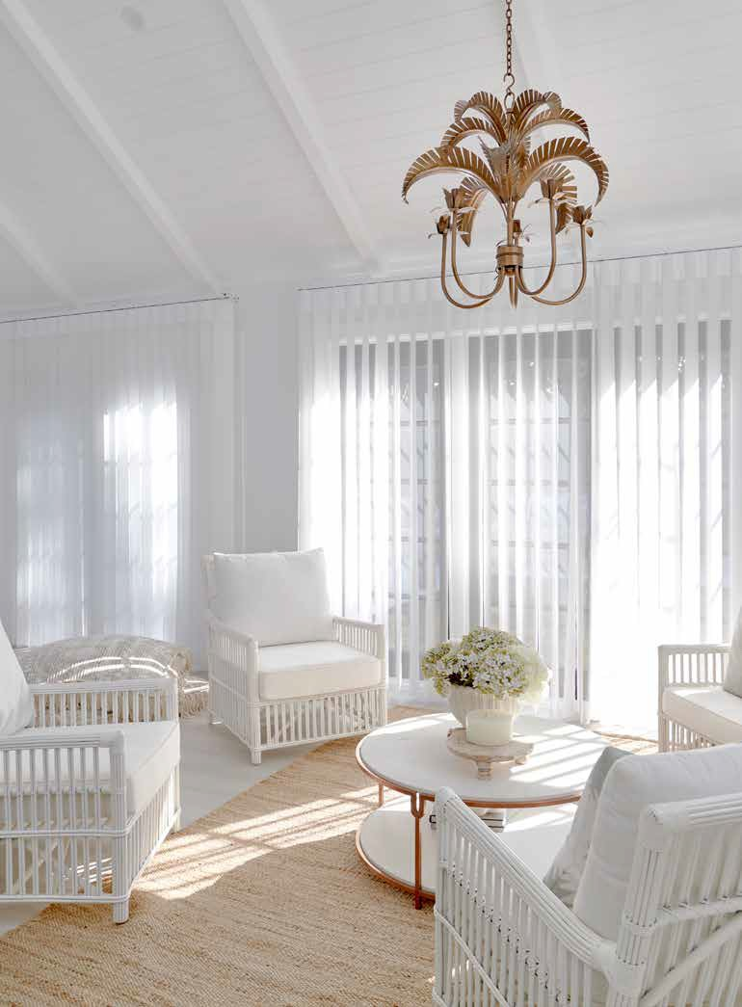
Installation

Slide 16
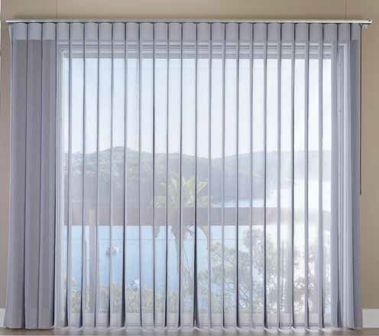
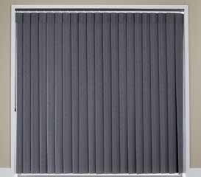
Installation: Face Fit or Reveal Fit
Choose between face fit or reveal fit options
Face Fit
Reveal Fit
Floor-to-ceiling face fit is recommended
Complete coverage of light gaps
Easier access to the operating controls
Brackets are not as visible for a floor-to-ceiling shade
Light gaps are more visible between the track and fabric and at the non-control end
Harder to access the operating controls
Reveal fit compresses the end vanes giving an inconsistent appearance

Slide 17
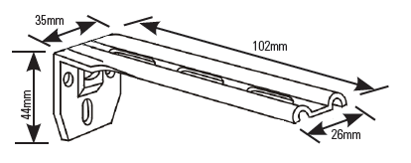
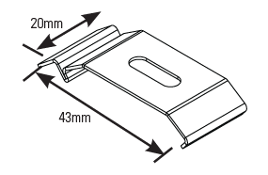
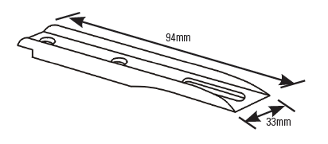
Installation: Brackets
Face Fit
Reveal Fit
Face Fit Mounting Bracket & Clip-In Mounting Bracket
Clip-In Mounting Bracket
Optional
Extension
Plate

Slide 18
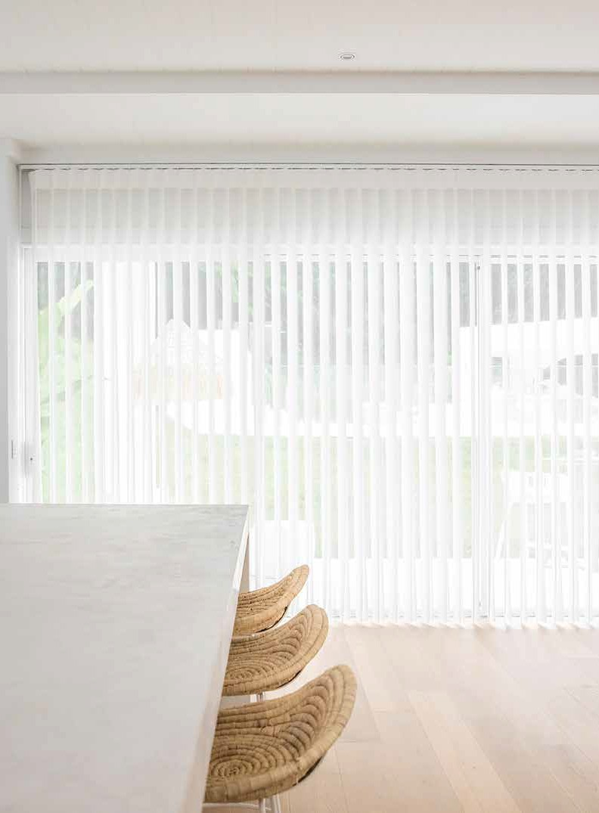
What to Expect

Slide 19
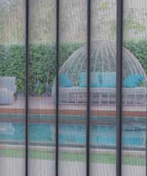
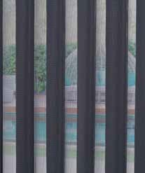
What to Expect
FABRIC VANES
Each vane consists of one sheer panel attached to two room darkening panels.
Open Position
Partially Opened
Closed
When vanes are open the fabric provides a diffused view through, to the outside and from the outside in.
Diffused light. The level of privacy depends on the degree which the fabric vanes are open to.
Vanes can be closed for complete privacy.

Slide 20
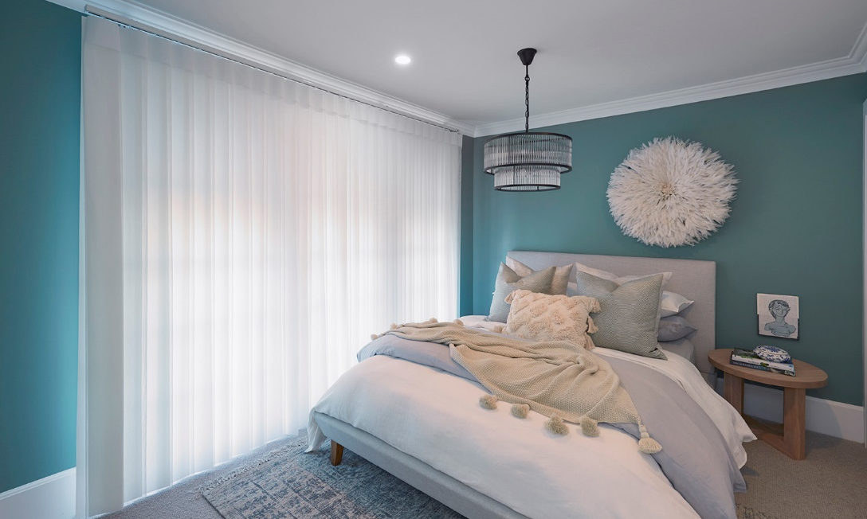
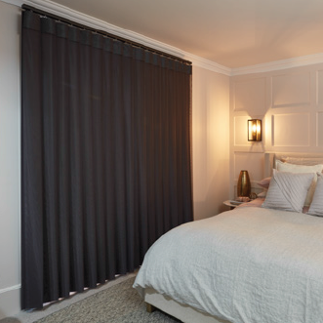
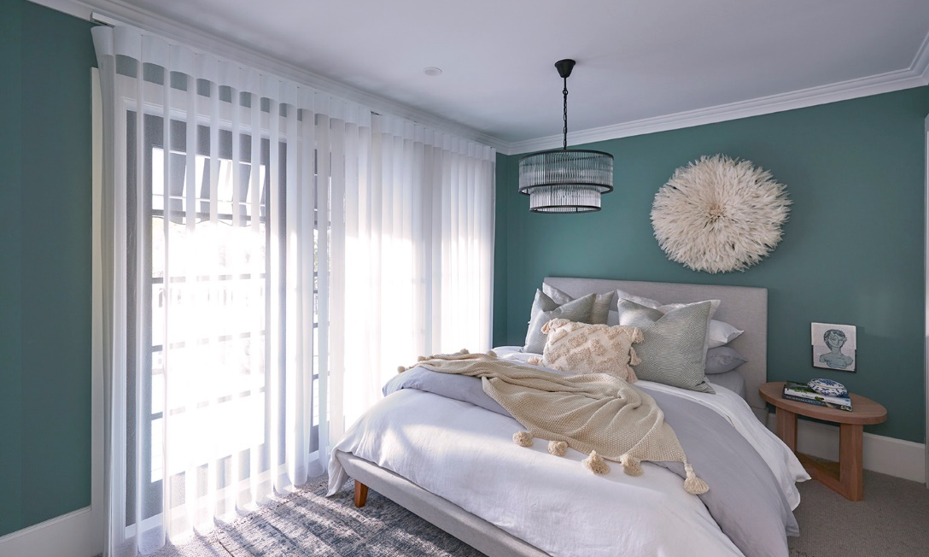
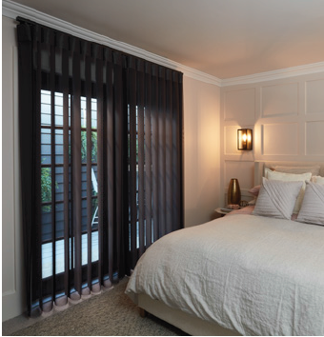
What to Expect
LIGHT CONTROL & PRIVACY
Easily adjust the level of privacy and light or close the shade completely for room darkening
For Light Coloured Fabric
For Dark Coloured Fabric
Light coloured fabrics provide a soft glow effect.
Dark coloured fabrics will give you a room darkening effect.

Slide 21
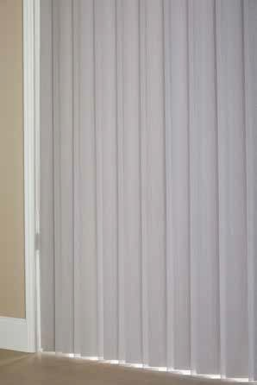
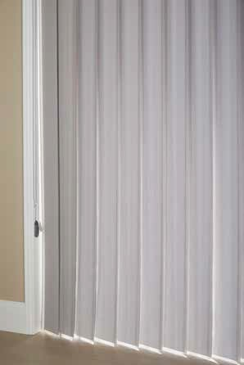
What to Expect
VANE CLOSURE & OVERLAP
The fabric vanes are designed to overlap 25mm for privacy.
Closure TOWARDS the control side:
Closure AWAY from the control side:
Vane closure is tighter in the direction towards the control side, reducing light gap between the fabric vanes.
When vanes are tilted this way, the vane closure is not as tight and there may be light leakage which will be visible when viewed from the side.
The light gap may also increase towards to lower part of the vanes.
This is an expected characteristic of the product.

Slide 22
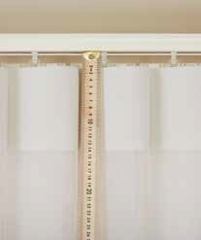
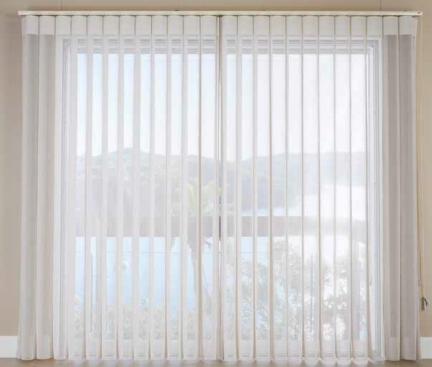
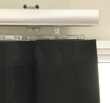
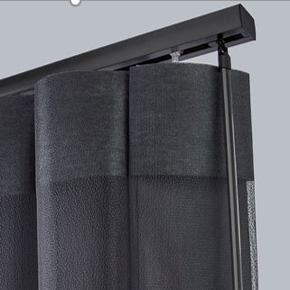
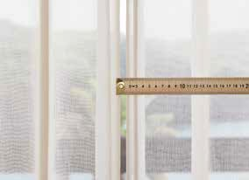
What to Expect
LIGHT GAPS
Under the track
At both ends
For split stack
Light gap between the track and fabric is 20mm.
The non-control end will finish short of the track due to the vane closing requirement.
The gap for split stack is 10 – 15 mm due to the folding of end vanes.
For the wand control system, there will be a space between the end of the track and the position of the wand.

Slide 23
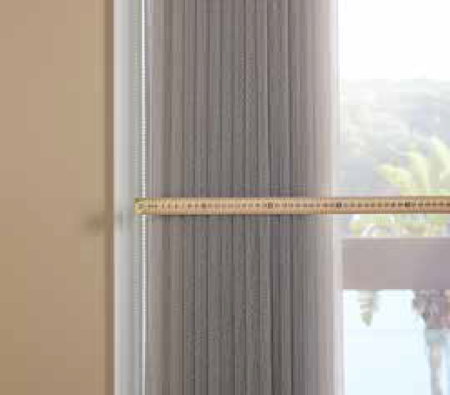
What to Expect
FABRIC STACKBACK
We recommend calculating the fabric stackback before placing
an order to make sure the fabric will stack clear of the window
or sliding door opening for better views.
Stackback refers to the width of the stacked fabric on either side when the shade is drawn open
The calculation below is based on the Standard fabric range to be use as a guideline; some variation can be expected based on fabric thickness.
Stackback calculation
0 - 2000 mm
2001 - 4500 mm
4500 mm +
20% of the shade width
15% of the shade width
10% of the shade width
Example: Shade width 3500mm = 525mm stackback (15% x 3500mm)

Slide 24
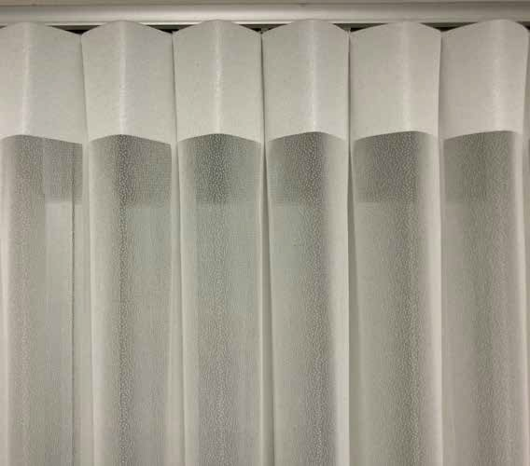
What to Expect
REGULAR OPERATION
It’s important that your shades are operated regularly to prevent dust build up and potential creases in the fabric.
If a shade is left in the stacked position (drawn open) for an extended period of time, creases can form in the fabric starting from the top of the shade and gradually extend down the shade.
Creased header shown

Slide 25
Product Care & Cleaning

Slide 26
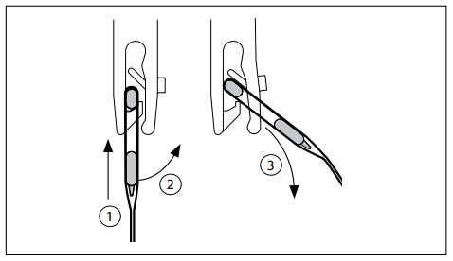
Product Care & Cleaning
DUSTING
Surface dust can be removed using a clean soft brush or feather duster.
SPOT CLEANING
To remove dirt and grime, simply wipe the fabric vanes with a sponge soaked in lukewarm water.
If marks are still visible, add a little mild detergent and gently dry with a clean cloth. We recommend that you spot clean a small area as a test first.
Do not use harsh cloths, harsh abrasives, chlorine or ammonia-based chemicals or cleaners on any surfaces as they may affect the surface appearance and durability.
HAND WASH
VeriShade XT fabric can be lightly hand washed and dried and can also be ironed with a cool iron or steamed to remove creases.
To remove fabric, gently unhook the fabric vane by lifting the vane up and out of the hook.

Slide 27
